Slide 1
Metrics for KWS

Slide 2


Collect
Data
Preprocess
Data
Design a
Model
Train a
Model
Evaluate
Optimize
Convert
Model
Deploy
Model
Make
Inferences
Micro
Notes:
We are now moving to designing a model!

Slide 3
Collect
Data
Preprocess
Data
Design a
Model
Train a
Model
Evaluate
Optimize
Convert
Model
Deploy
Model
Make
Inferences
Micro
Notes:
We are now moving to designing a model!

Slide 4

What metrics matter?
Accuracy
Notes:
From 3-5-3
Humans: https://thenounproject.com/search/?q=mom+kid&i=29968

Slide 5



What metrics matter?
Accuracy
Efficiency
Notes:
From 3-5-3
Humans: https://thenounproject.com/search/?q=mom+kid&i=29968

Slide 6
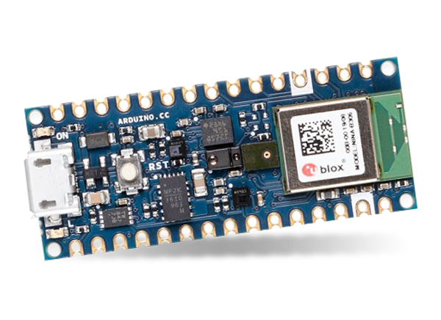
What metrics matter?
Accuracy
Efficiency
Notes:
From 3-5-3
Humans: https://thenounproject.com/search/?q=mom+kid&i=29968

Slide 7

What metrics matter?
Accuracy
Efficiency
Beyond Model Metrics
Notes:
From 3-5-3
Humans: https://thenounproject.com/search/?q=mom+kid&i=29968

Slide 8
What metrics matter?
Accuracy
Efficiency
Beyond Model Metrics
Notes:
From 3-5-3
Humans: https://thenounproject.com/search/?q=mom+kid&i=29968

Slide 9
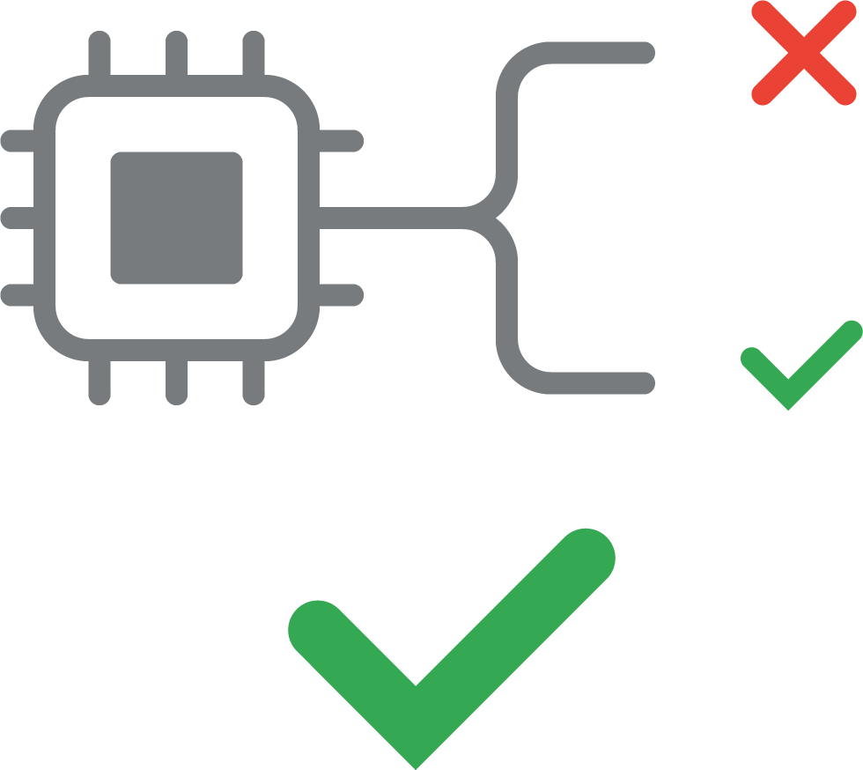
False Positive
ERROR
Did NOT say keyword
but device DOES trigger
REAL
Notes:
https://thenounproject.com/search/?q=false+positive&i=2985145

Slide 10
False Negative
ERROR
DID say keyword
but device DOES NOT trigger
REAL
Notes:
https://thenounproject.com/search/?q=false+positive&i=2985145

Slide 11
False Positive and False Negative
Accuracy is measured as a tradeoff between false accept rate (FAR) and false reject rate (FRR)
False Rejects per Instance
False Accepts per Hour
Notes:
receiver operating characteristic curve, or ROC curve, is a graphical plot that illustrates the diagnostic ability of a binary classifier system as its discrimination threshold is varied.

Slide 12
False Positive and False Negative
Accuracy is measured as a tradeoff between false accept rate (FAR) and false reject rate (FRR)
Choose an operating point
False Rejects per Instance
False Accepts per Hour
Notes:
receiver operating characteristic curve, or ROC curve, is a graphical plot that illustrates the diagnostic ability of a binary classifier system as its discrimination threshold is varied.

Slide 13
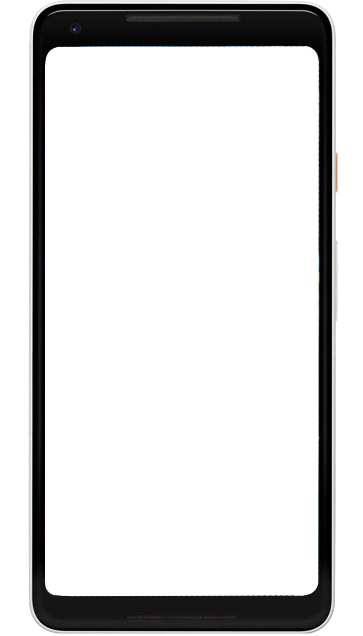
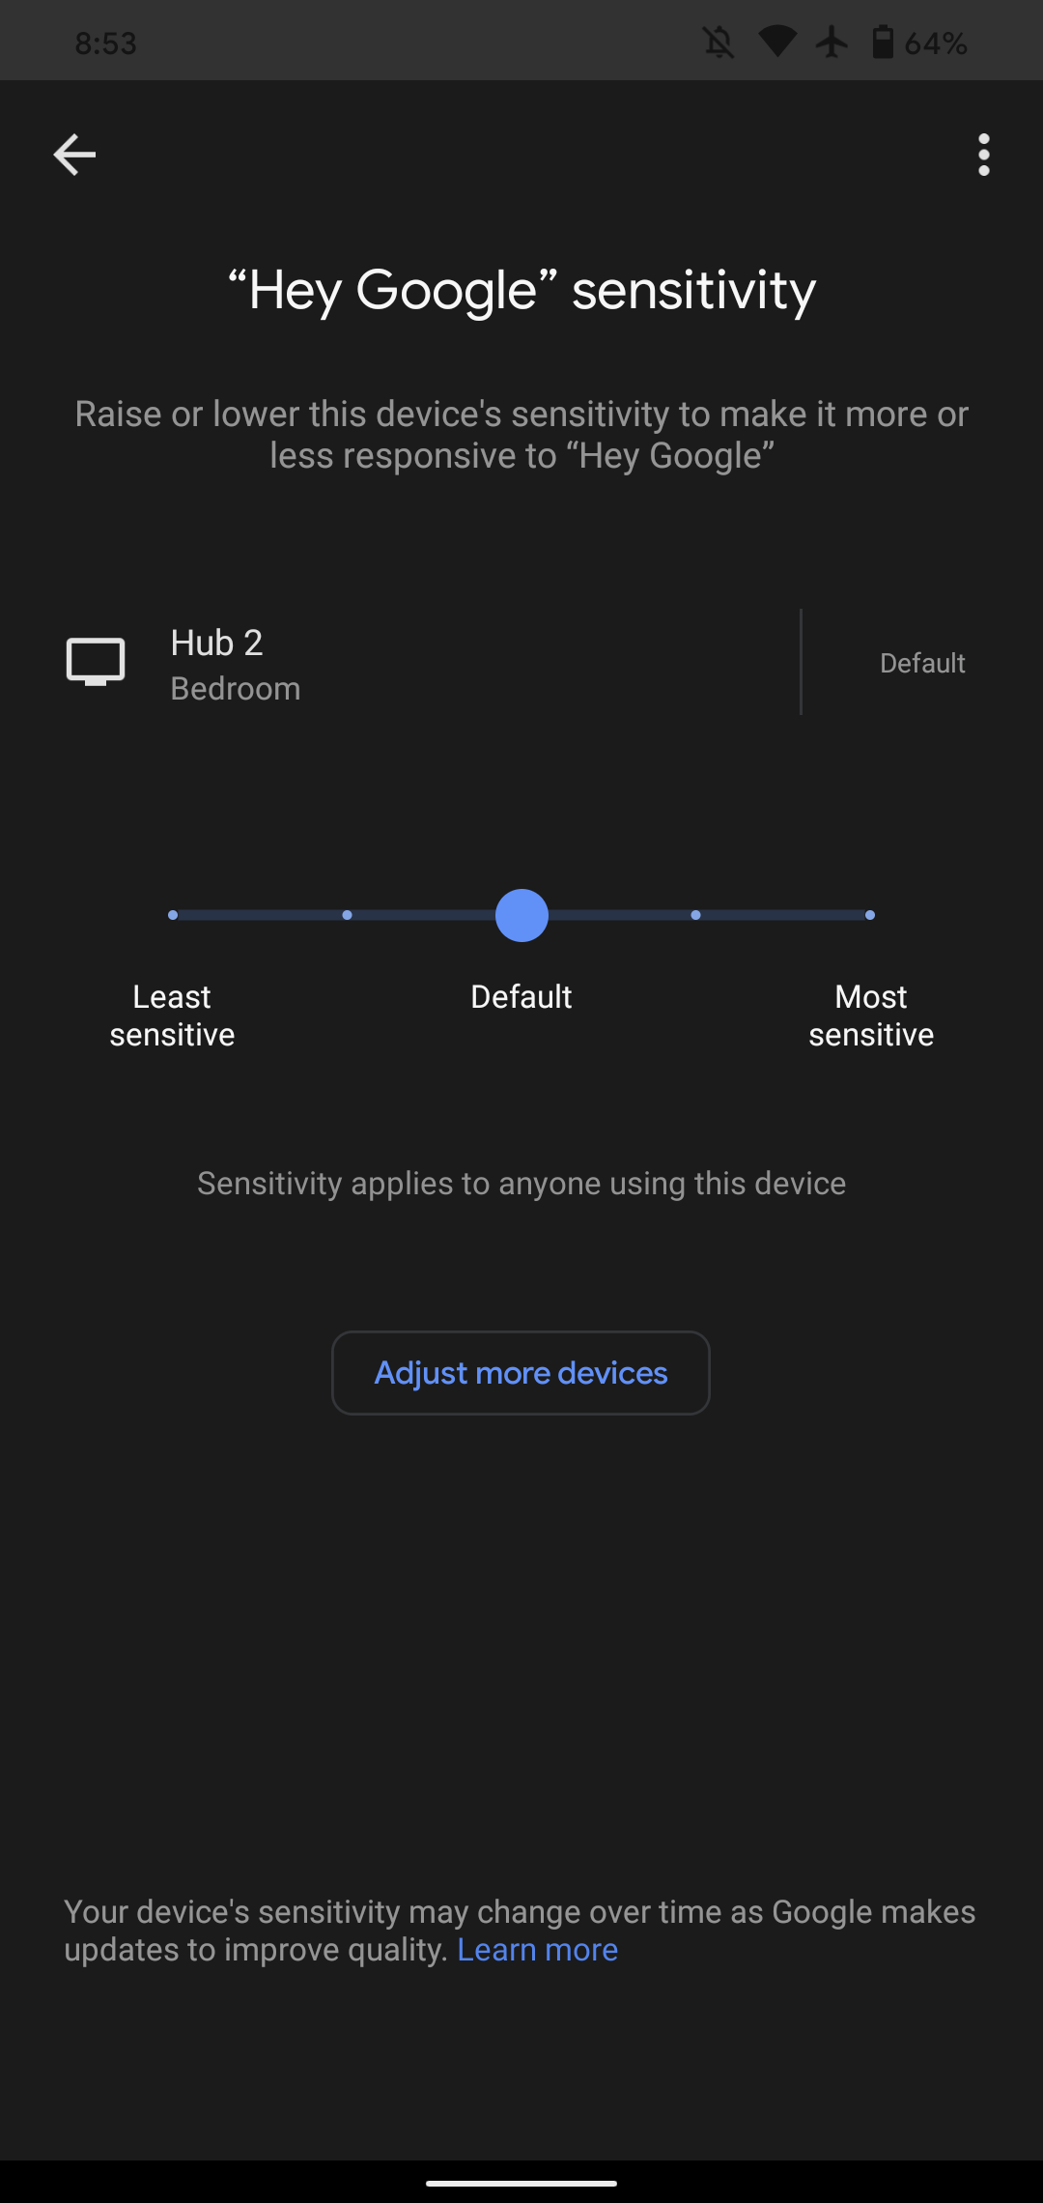
Operating Point
False Accept Rate and False Reject Rate are measured on particular audio
False Accept Rate and False Reject Rate are measured on particular audio.
But...
● Your phone might be in your pocket, purse, or backpack most of the day
● Your smart speaker might be next to a TV, or next to where your family eats, or in a relatively quiet bedroom
● You might not be a native speaker of English

Slide 14
Operating Point
False Accept Rate and False Reject Rate are measured on particular audio—however
Your phone might be in your pocket, purse, or backpack most of the day
False Accept Rate and False Reject Rate are measured on particular audio.
But...
● Your phone might be in your pocket, purse, or backpack most of the day
● Your smart speaker might be next to a TV, or next to where your family eats, or in a relatively quiet bedroom
● You might not be a native speaker of English

Slide 15
Operating Point
False Accept Rate and False Reject Rate are measured on particular audio—however
Your phone might be in your pocket, purse, or backpack most of the day
Your smart speaker might be next to a TV, or next to where your family eats, or in a relatively quiet bedroom
False Accept Rate and False Reject Rate are measured on particular audio.
But...
● Your phone might be in your pocket, purse, or backpack most of the day
● Your smart speaker might be next to a TV, or next to where your family eats, or in a relatively quiet bedroom
● You might not be a native speaker of English

Slide 16
Operating Point
False Accept Rate and False Reject Rate are measured on particular audio—however
Your phone might be in your pocket, purse, or backpack most of the day
Your smart speaker might be next to a TV, or next to where your family eats, or in a relatively quiet bedroom
You might not be a native speaker of English
False Accept Rate and False Reject Rate are measured on particular audio.
But...
● Your phone might be in your pocket, purse, or backpack most of the day
● Your smart speaker might be next to a TV, or next to where your family eats, or in a relatively quiet bedroom
● You might not be a native speaker of English

Slide 17
False Rejects per Instance
False Accepts per Hour

Slide 18
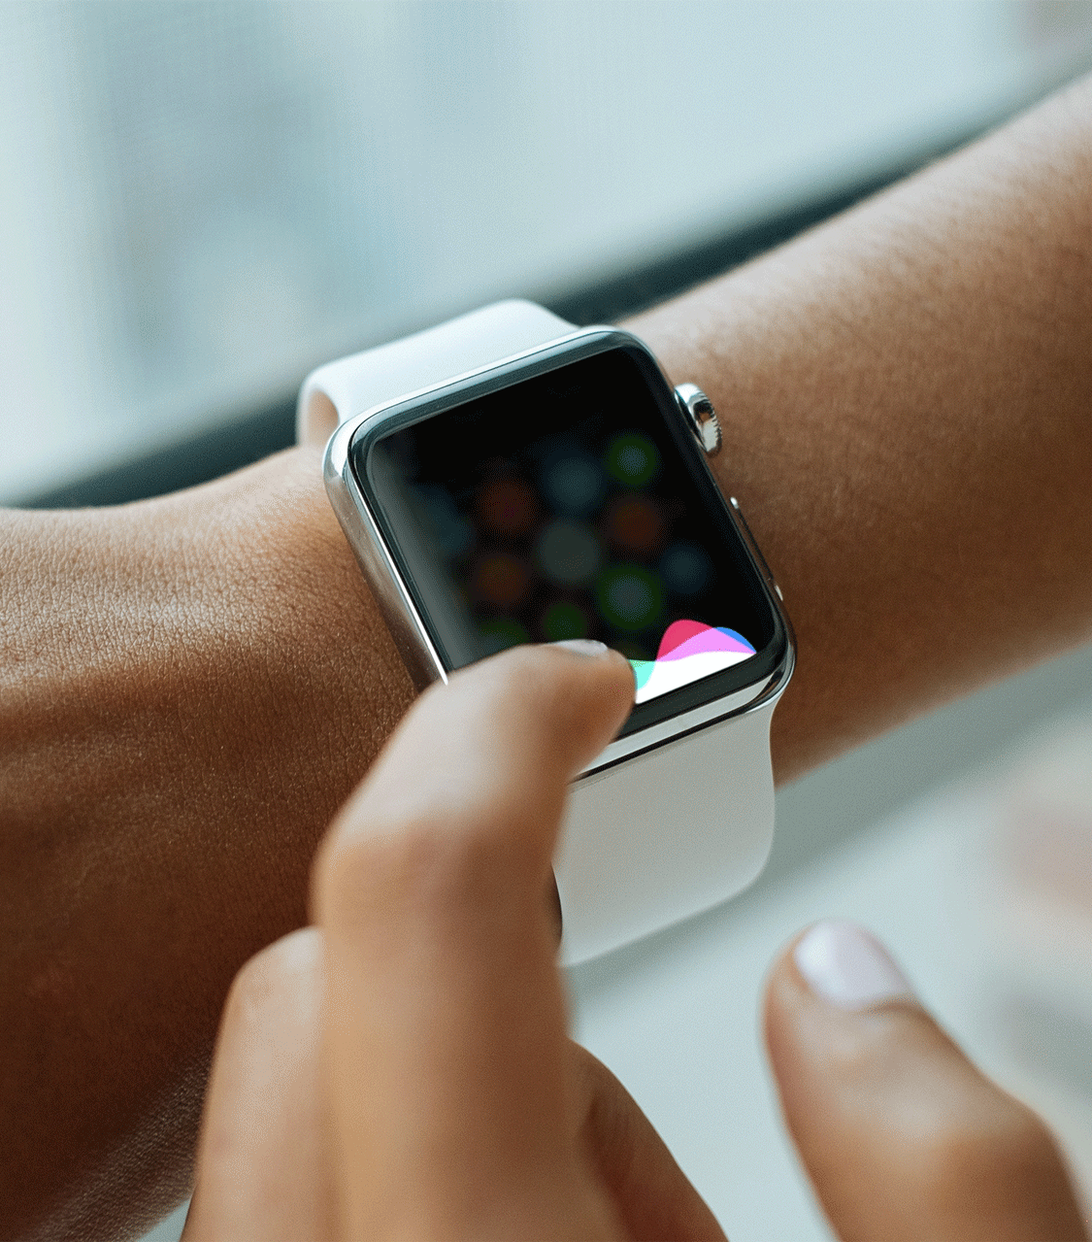
Latency
Model must be fast enough to keep up with the speech input

Slide 19
Latency
Model must be fast enough to keep up with the speech input
The model must run fast enough to be responsive to the end user

Slide 20
What metrics matter?
Accuracy
Efficiency
Beyond Model Metrics
Notes:
From 3-5-3
Humans: https://thenounproject.com/search/?q=mom+kid&i=29968

Slide 21
Latency
Model must be fast enough to keep up with the speech input
The model must run fast enough to be responsive to the end user
But it must run efficiently on a small processor TinyML

Slide 22
Memory Usage
Need to be resource aware

Slide 23
Memory Usage
Need to be resource aware
Less compute
Less memory
Use quantization

Slide 24
Memory Usage
Need to be resource aware
Less compute
Less memory
Use quantization
128
112
96
80
Memory Usage (KB)
64
48
32
16
0

Slide 25
Memory Usage
Need to be resource aware
Less compute
Less memory
Use quantization
128
112
96
Application Code
80
Memory Usage (KB)
64
48
32
16
0

Slide 26
Memory Usage
Need to be resource aware
Less compute
Less memory
Use quantization
128
112
TFLite Micro
96
Application Code
80
Memory Usage (KB)
64
48
32
16
0

Slide 27
Memory Usage
Need to be resource aware
Less compute
Less memory
Use quantization
128
112
Model
TFLite Micro
96
Application Code
80
Memory Usage (KB)
64
48
32
16
0

Slide 28
Memory Usage
Need to be resource aware
Less compute
Less memory
Use quantization
128
Working Memory
112
Model
TFLite Micro
96
Application Code
80
Memory Usage (KB)
64
48
32
16
0

Slide 29
Memory Usage
Need to be resource aware
Less compute
Less memory
Use quantization
128
Audio Buffer
Working Memory
112
Model
TFLite Micro
96
Application Code
80
Memory Usage (KB)
64
48
32
16
0

Slide 30
Memory Usage
Need to be resource aware
Less compute
Less memory
Use quantization
128
Audio Buffer
Working Memory
112
Model
TFLite Micro
96
Application Code
80
Memory Usage (KB)
64
48
32
16
0

Slide 31
What metrics matter?
Accuracy
Efficiency
Beyond Model Metrics
Notes:
From 3-5-3
Humans: https://thenounproject.com/search/?q=mom+kid&i=29968

Slide 32
Beyond Model Metrics
Think about quality of experience (QoE)

Slide 33
Beyond Model Metrics
Think about quality of experience (QoE)
What really defines that? It isn’t just whether the model is performing well on a given dataset. It is about the user experience: how can we assess that?

Slide 34
Beyond Model Metrics
Think about quality of experience (QoE)
What really defines that? It isn’t just whether the model is performing well on a given dataset. It is about the user experience: how can we assess that?
Have diverse users to test against?

Slide 35
Beyond Model Metrics
Think about quality of experience (QoE)
What really defines that? It isn’t just whether the model is performing well on a given dataset. It is about the user experience: how can we assess that?
Have diverse users to test against?
Test in different backgrounds?

Slide 36
Beyond Model Metrics
Think about quality of experience (QoE)
What really defines that? It isn’t just whether the model is performing well on a given dataset. It is about the user experience: how can we assess that?
Have diverse users to test against?
Test in different backgrounds?
Add noise while training the models?

Slide 37
Collect
Data
Preprocess
Data
Design a
Model
Train a
Model
Evaluate
Optimize
Convert
Model
Deploy
Model
Make
Inferences
Micro
Notes:
We are now moving to designing a model!

Slide 38
So how can we improve our KWS Application?
Collect
Data
Preprocess
Data
Design a
Model
Train a
Model
Evaluate
Optimize
Convert
Model
Deploy
Model
Make
Inferences
Micro
Notes:
Note how we’d have to improve something before the evaluate step so…...
Model is limited because need it to be TINY so not much we can do there
you can try different kinds of training and using data augmentation etc. and that can help
We are already using spectrograms which are one of the best ways to process audio data for speech
The big winner in this case is DATA so we will focus on that in the next section!!!

